Slide 1
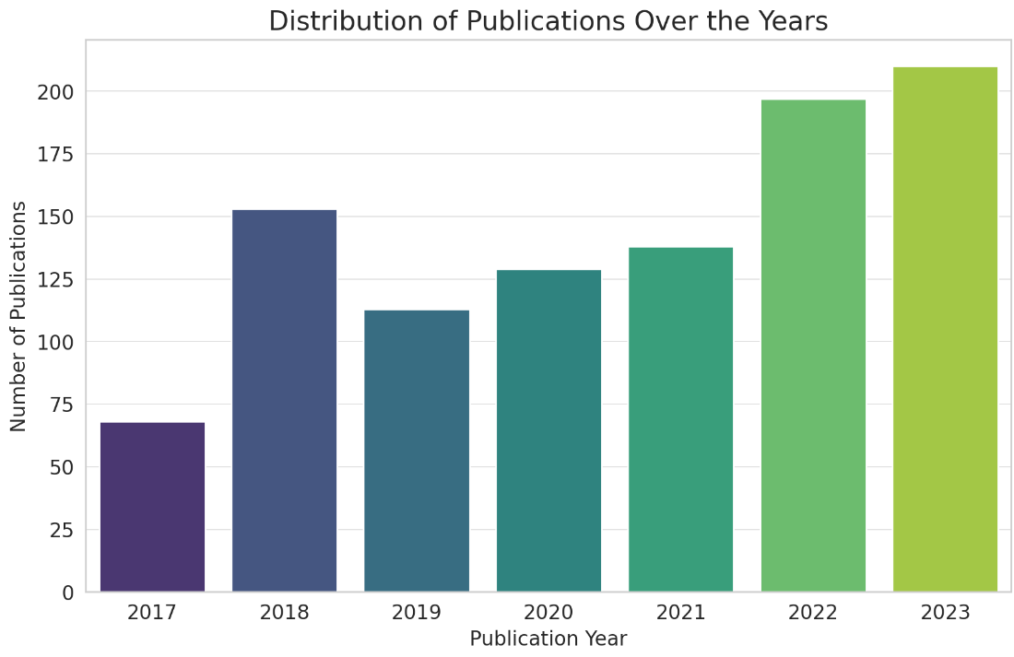
Exploratory Data Analysis Temporal Analysis
Temporal Analysis
Year | Number of Papers
2017 | 68
2018 | 153
2019 | 113
2020 (during COVID) | 129
2021 | 138
2022 | 197
2023 | 210
Notes:
There's a noticeable increase in publications from 2017 to 2018.
There's a slight dip in 2019.
The number of publications has been steadily increasing since 2020, with the highest count in 2023.

Slide 2
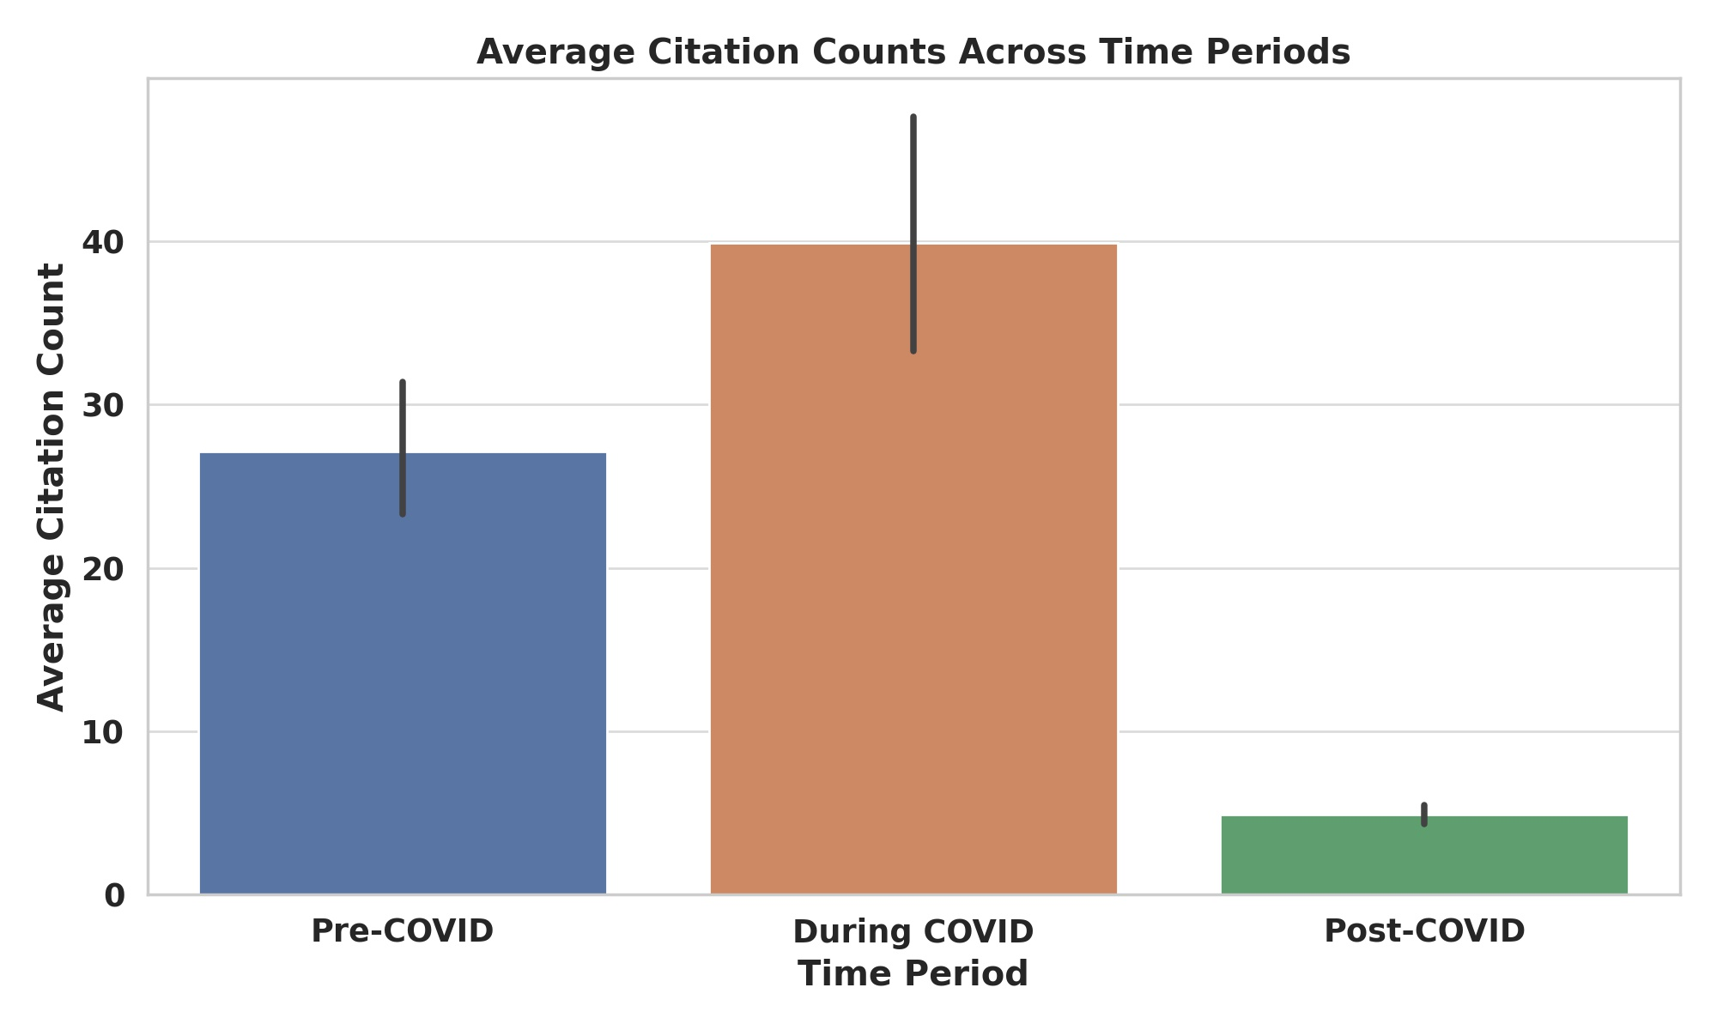
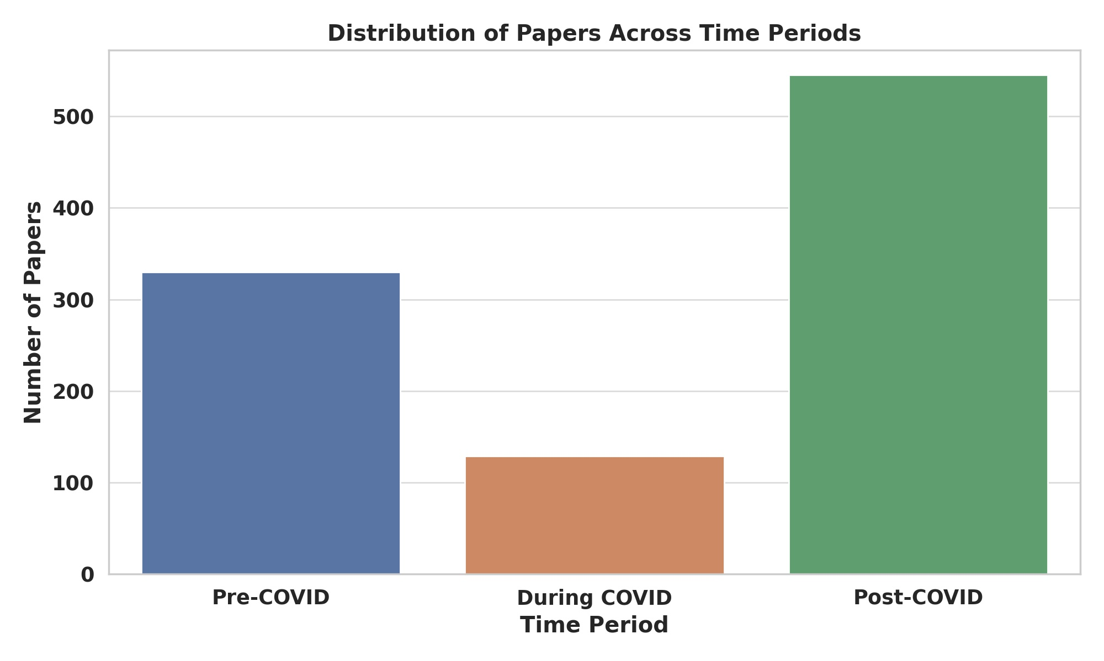
Exploratory Data Analysis
Temporal Analysis
Notes:
Data Enhancements:
Time Period Categorization:
The papers were categorized into three periods based on their publication year: Pre-COVID (before 2020), During COVID (2020), and Post-COVID (after 2020).
Distribution: 545 papers are from the Post-COVID period, 330 from the Pre-COVID period, and 129 from the During COVID period.
Authors and Affiliations Extraction:
A new processing step extracted individual authors and their respective affiliations from the Authors with Affiliations column and added them as new columns Authors and Affiliations.
Visualizations:
Distribution of Papers Across Time Periods:
The majority of the papers are from the Post-COVID period, followed by Pre-COVID, with the least number of papers from the During COVID period.
Average Citation Counts Across Time Periods:
The bar chart showcases the average citation counts of papers across the three periods.

Slide 3
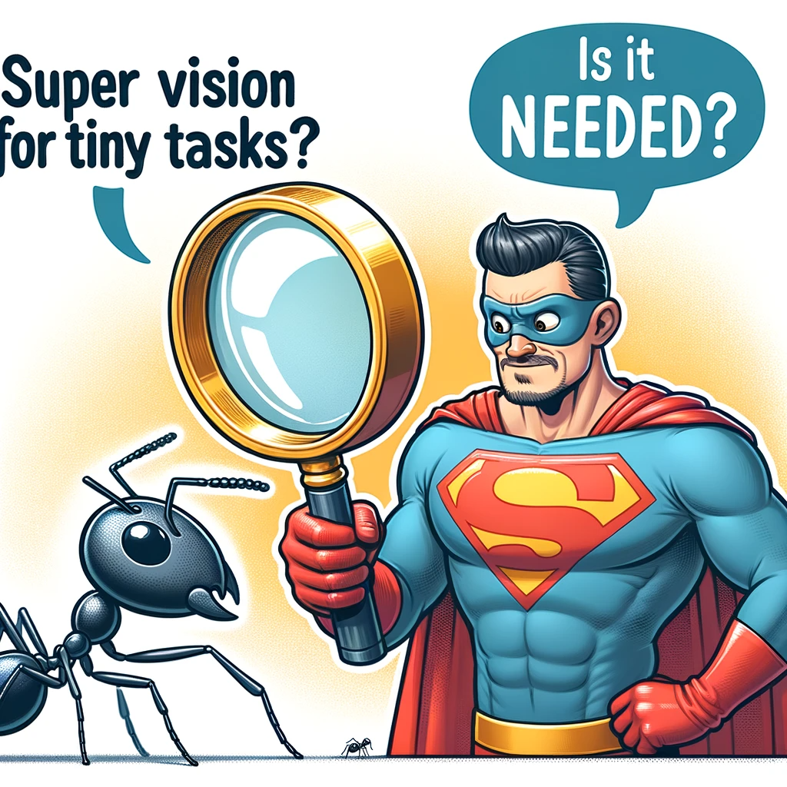
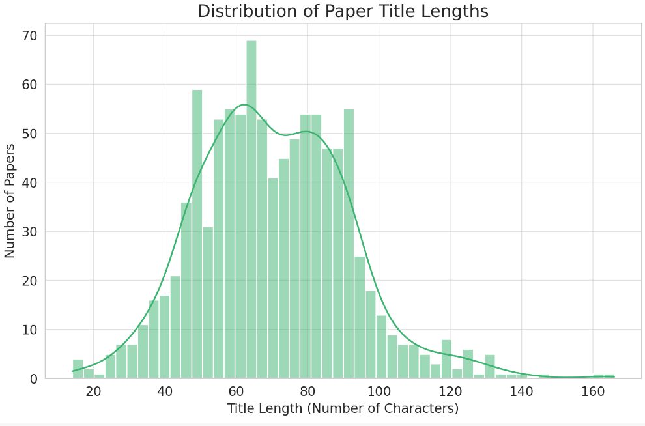
Exploratory Data Analysis
Distribution of paper title lengths
Notes:
Most paper titles have lengths between 50 to 100 characters.
There are a few titles that are notably shorter or longer, but the majority of titles fall within the mentioned range.

Slide 4
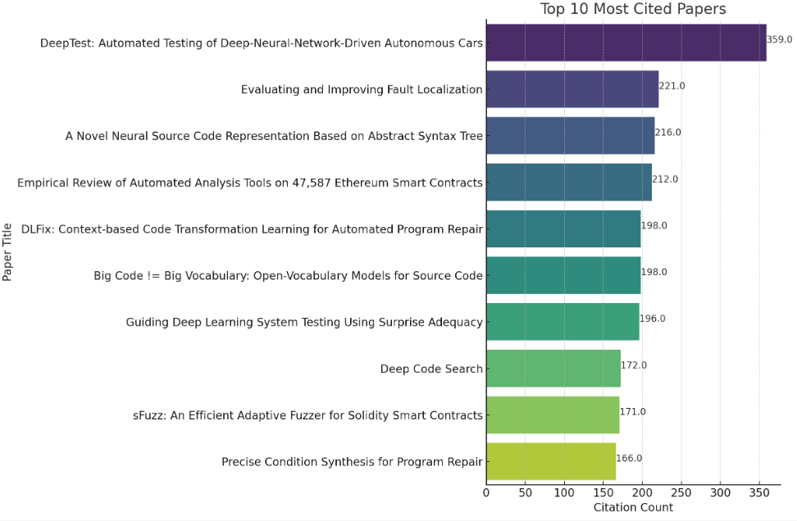
Exploratory Data Analysis
Most cited papers
Notes:
The visualization depicts the top 10 most cited papers. These papers have the highest citation counts, indicating their potential significance and impact in the field.

Slide 5

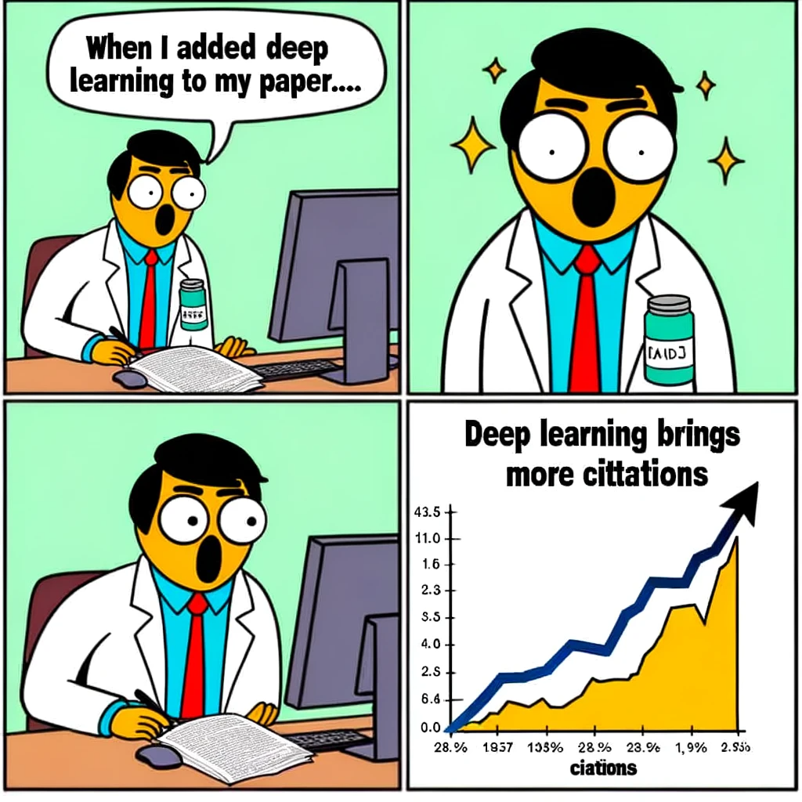
Exploratory Data Analysis
Most cited papers
Notes:
The visualization depicts the top 10 most cited papers. These papers have the highest citation counts, indicating their potential significance and impact in the field.

Slide 6
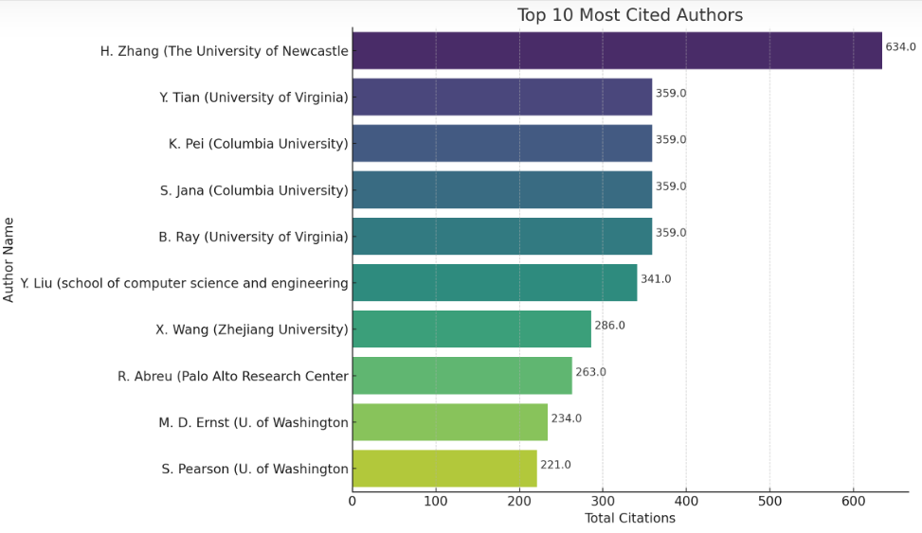
Exploratory Data Analysis
Most cited authors
Notes:
The visualization depicts the top 10 most cited papers. These papers have the highest citation counts, indicating their potential significance and impact in the field.

Slide 7
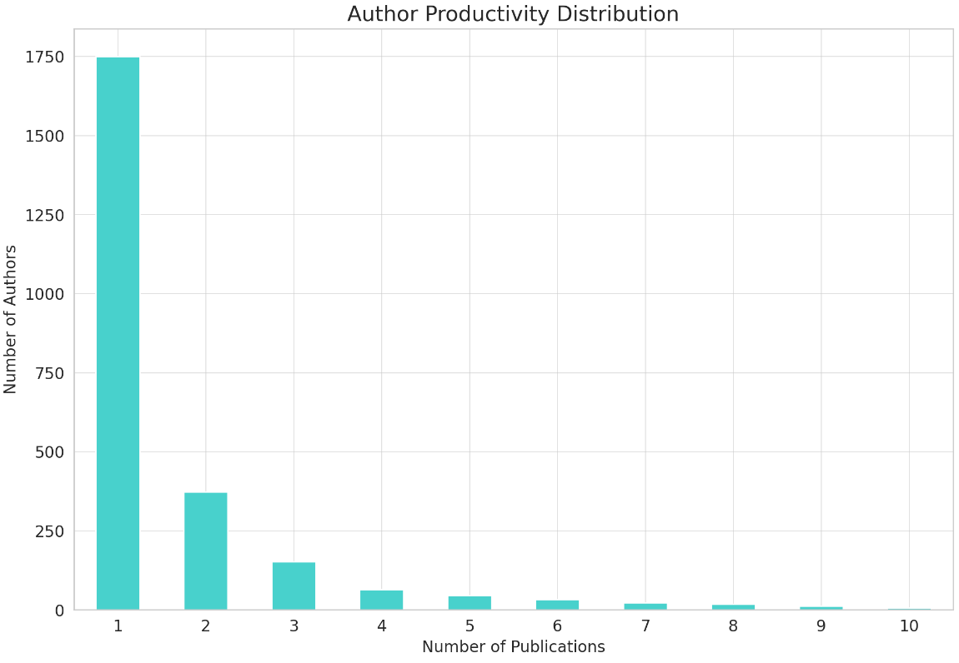
Exploratory Data Analysis
Author productivity
Notes:
The majority of authors have published only one paper in the dataset.
As the number of publications per author increases, the number of authors with that many publications decreases.
There are fewer authors who have published 2, 3, or more papers, with the count diminishing as the number of publications increases.

Slide 8
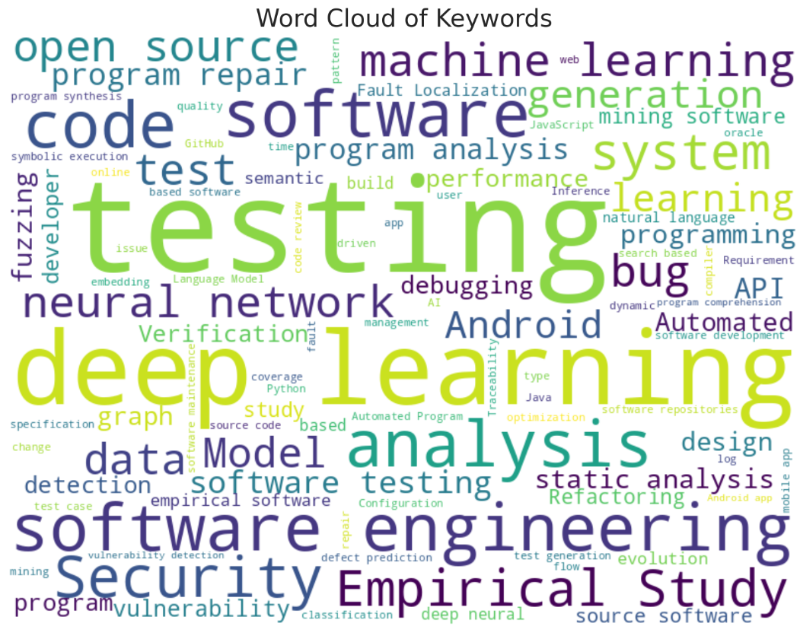
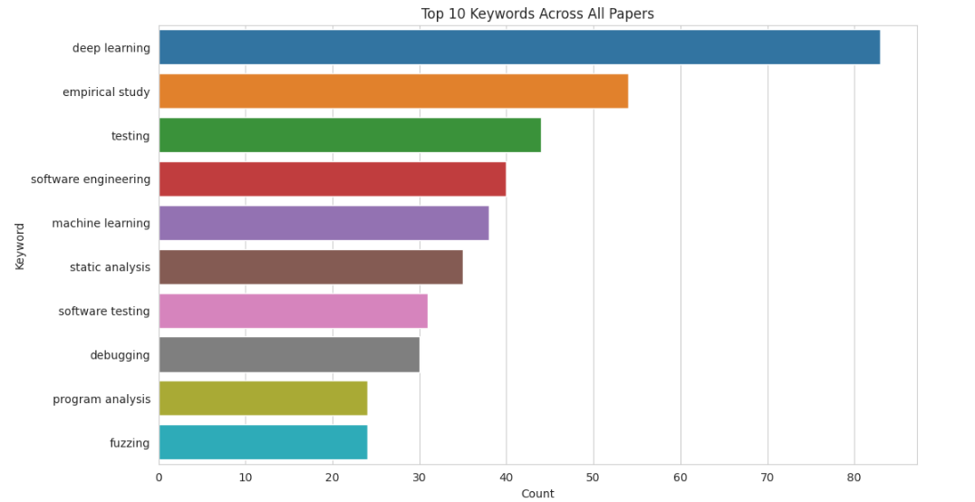
Exploratory Data Analysis
Keywords Across All Papers

Slide 9
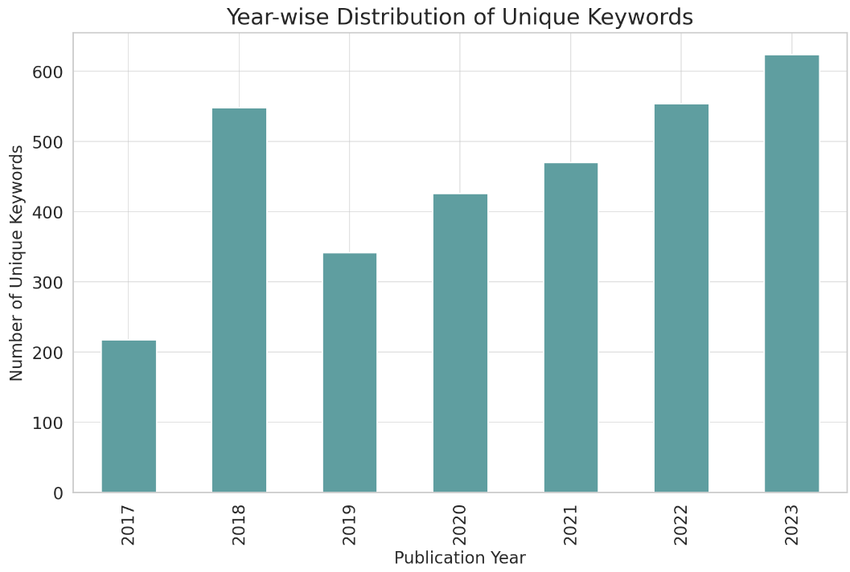

Exploratory Data Analysis
Year-wise distribution of unique keywords
Notes:
The bar chart showcases the distribution of unique keywords used in papers for each year:
There's a general upward trend in the diversity of research topics, as indicated by the increasing number of unique keywords over the years.
2023 has the highest diversity of research topics, with the maximum number of unique keywords.

Slide 10
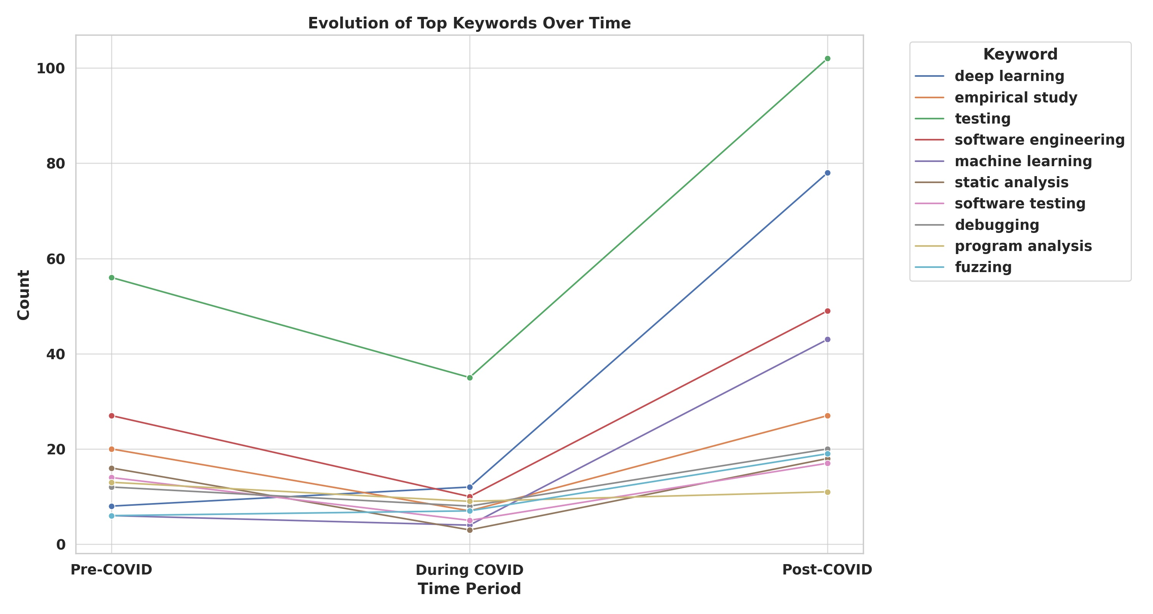
Exploratory Data Analysis
Keyword Analysis Findings
Notes:
The plot showcases the evolution of the top keywords over the three distinct time periods: Pre-COVID, During COVID, and Post-COVID.
Description:
The line chart captures the trend of the ten most frequent keywords identified earlier across the three periods.
Each keyword's trend line is uniquely colored, allowing for easy distinction between keywords.
The inclusion of markers ("o") on the lines helps highlight the specific counts for each period.
From a glance, it is evident that some keywords have seen increased mentions post-COVID, while others have remained relatively consistent or even decreased.
This chart provides a clear perspective on the shifting research focus over the seven-year span and can be instrumental in understanding the impact of the COVID-19 pandemic on research topics within the ICSE community.

Slide 11
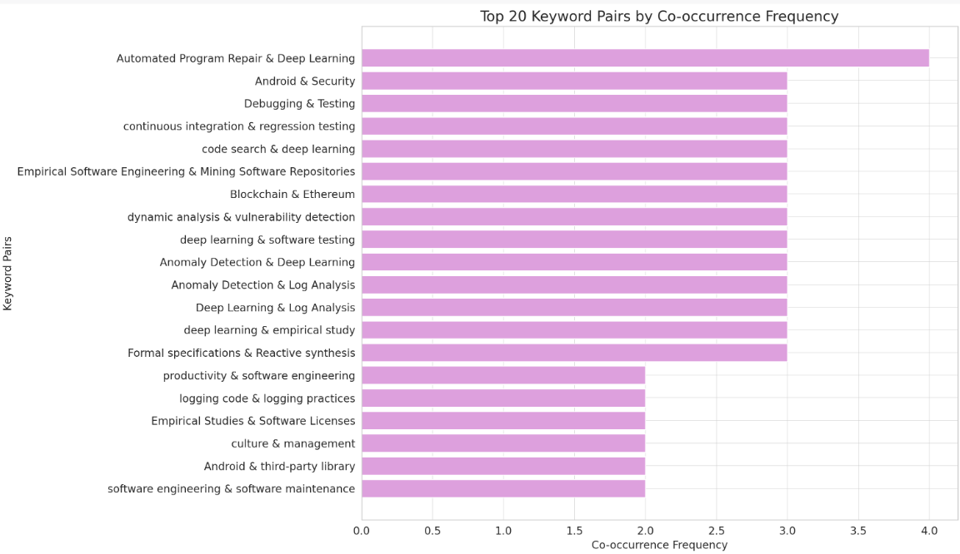
Exploratory Data Analysis
Keyword co-occurance
Notes:
The bar chart showcases the top 20 keyword pairs by co-occurrence frequency:
These pairs indicate the combination of keywords that frequently appear together in the same papers.
Such co-occurrences can signify interconnected or complementary research themes.

Slide 12
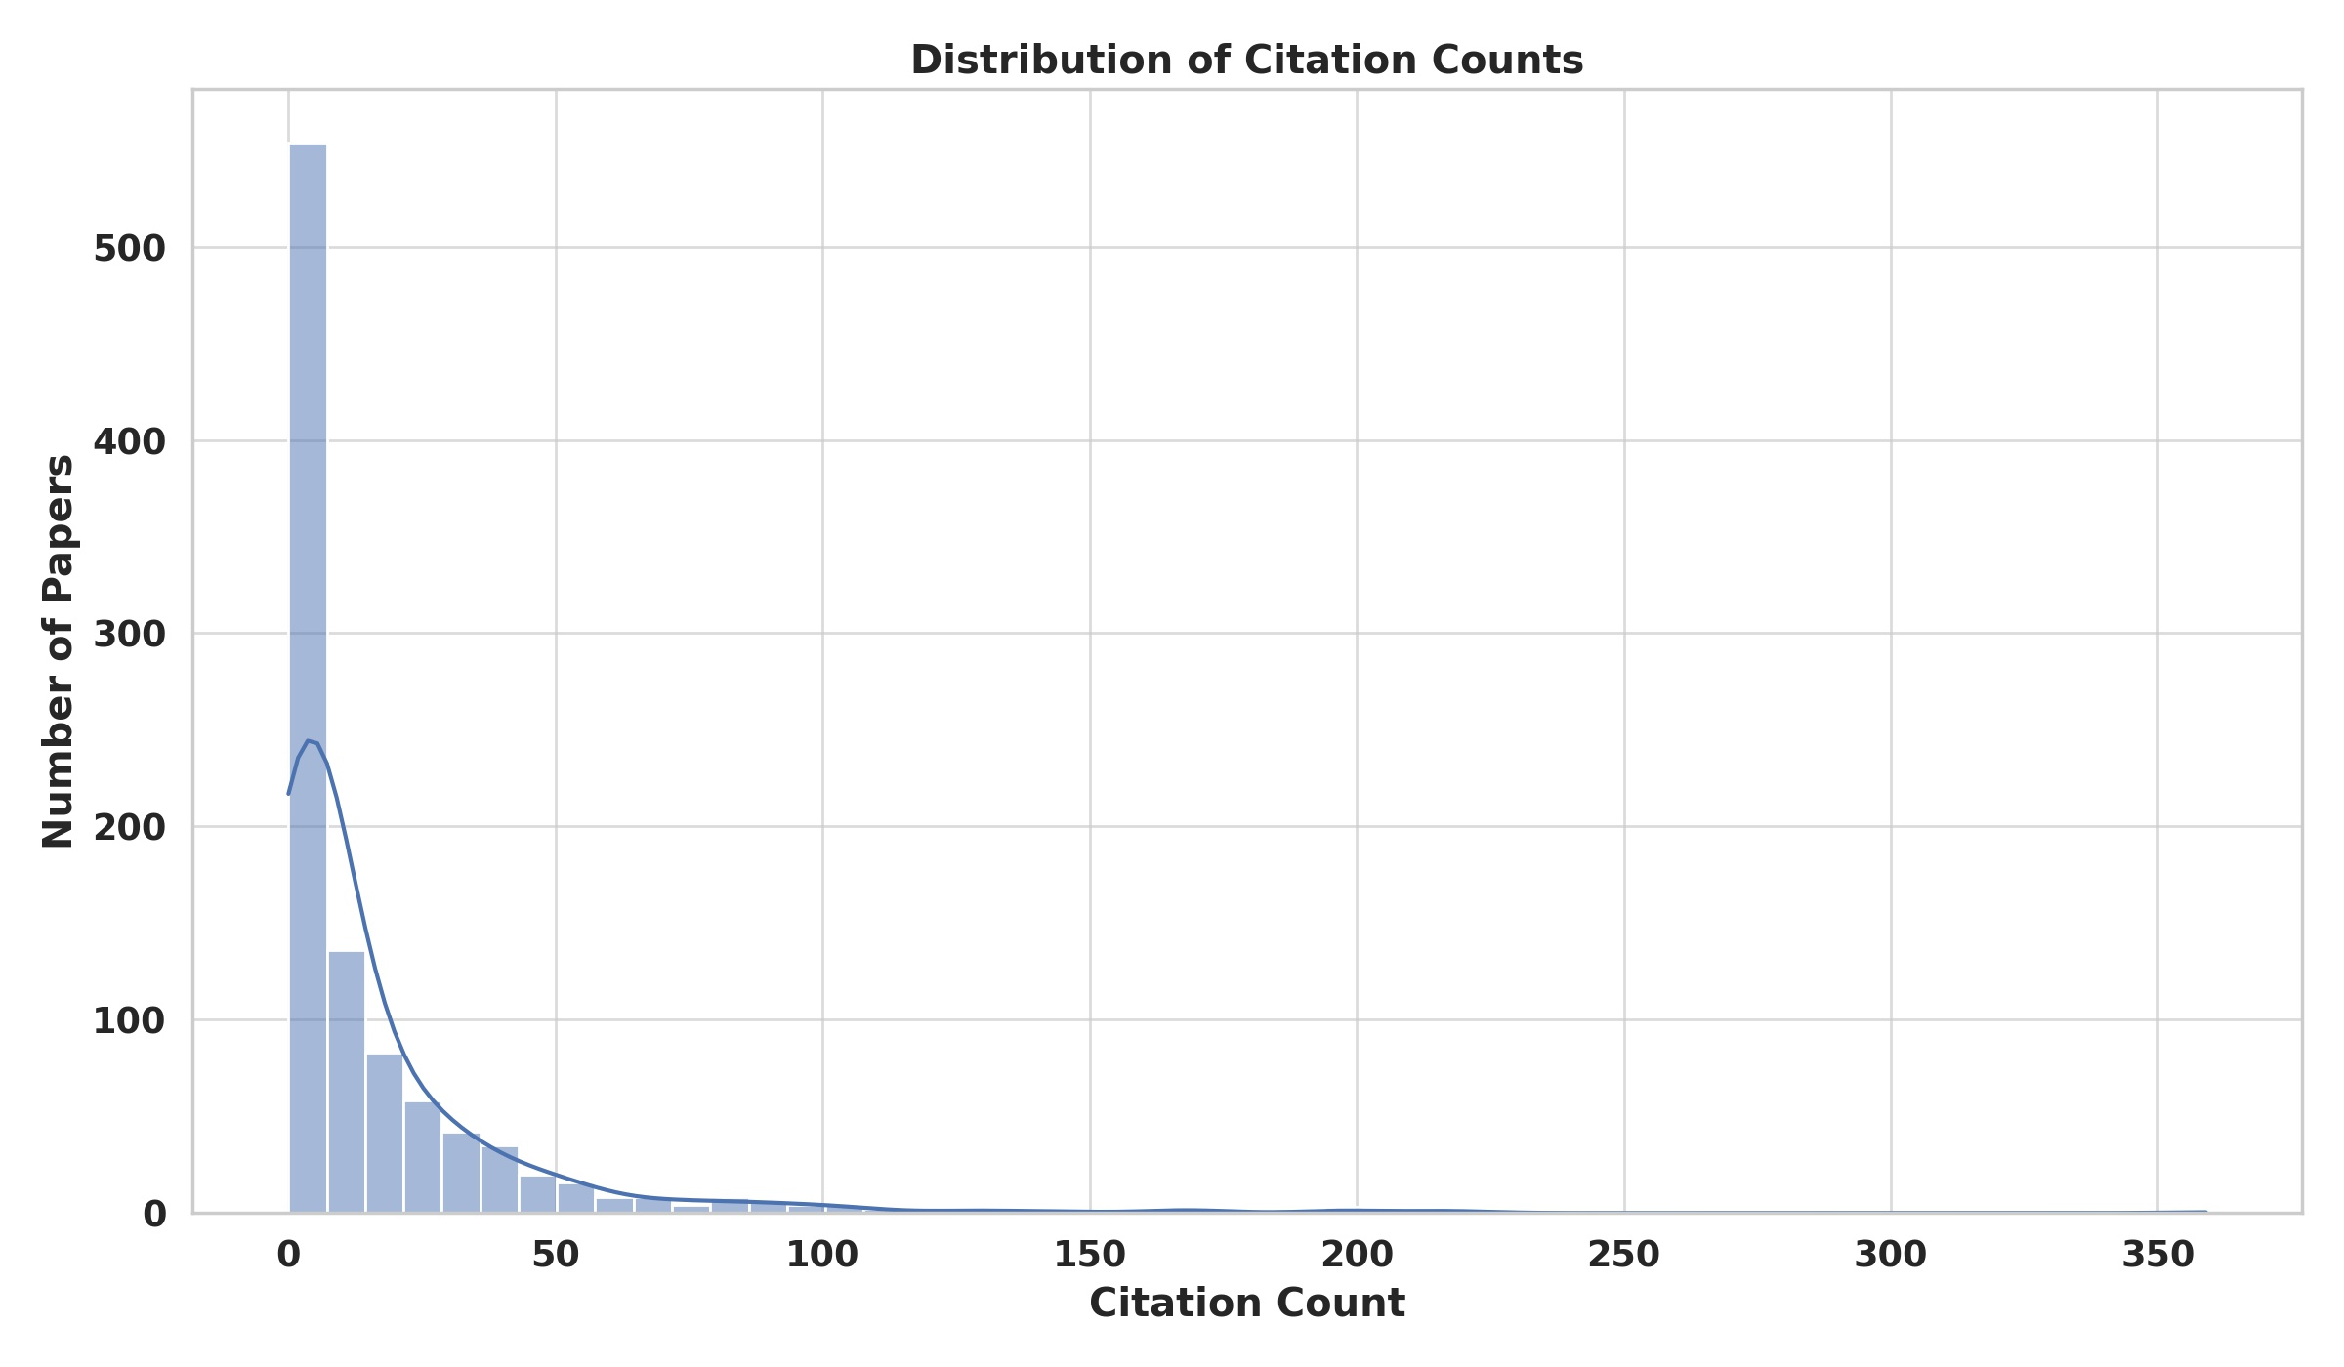
Exploratory Data Analysis
Distribution of Citation
Notes:
The histogram shows the distribution of citation counts across all papers. A few observations:
A significant number of papers have low citation counts, indicating they might be relatively newer or less referenced in the field.
There are a few papers with notably higher citation counts, as we saw in the previous visualization of the top 10 cited papers.

Slide 13
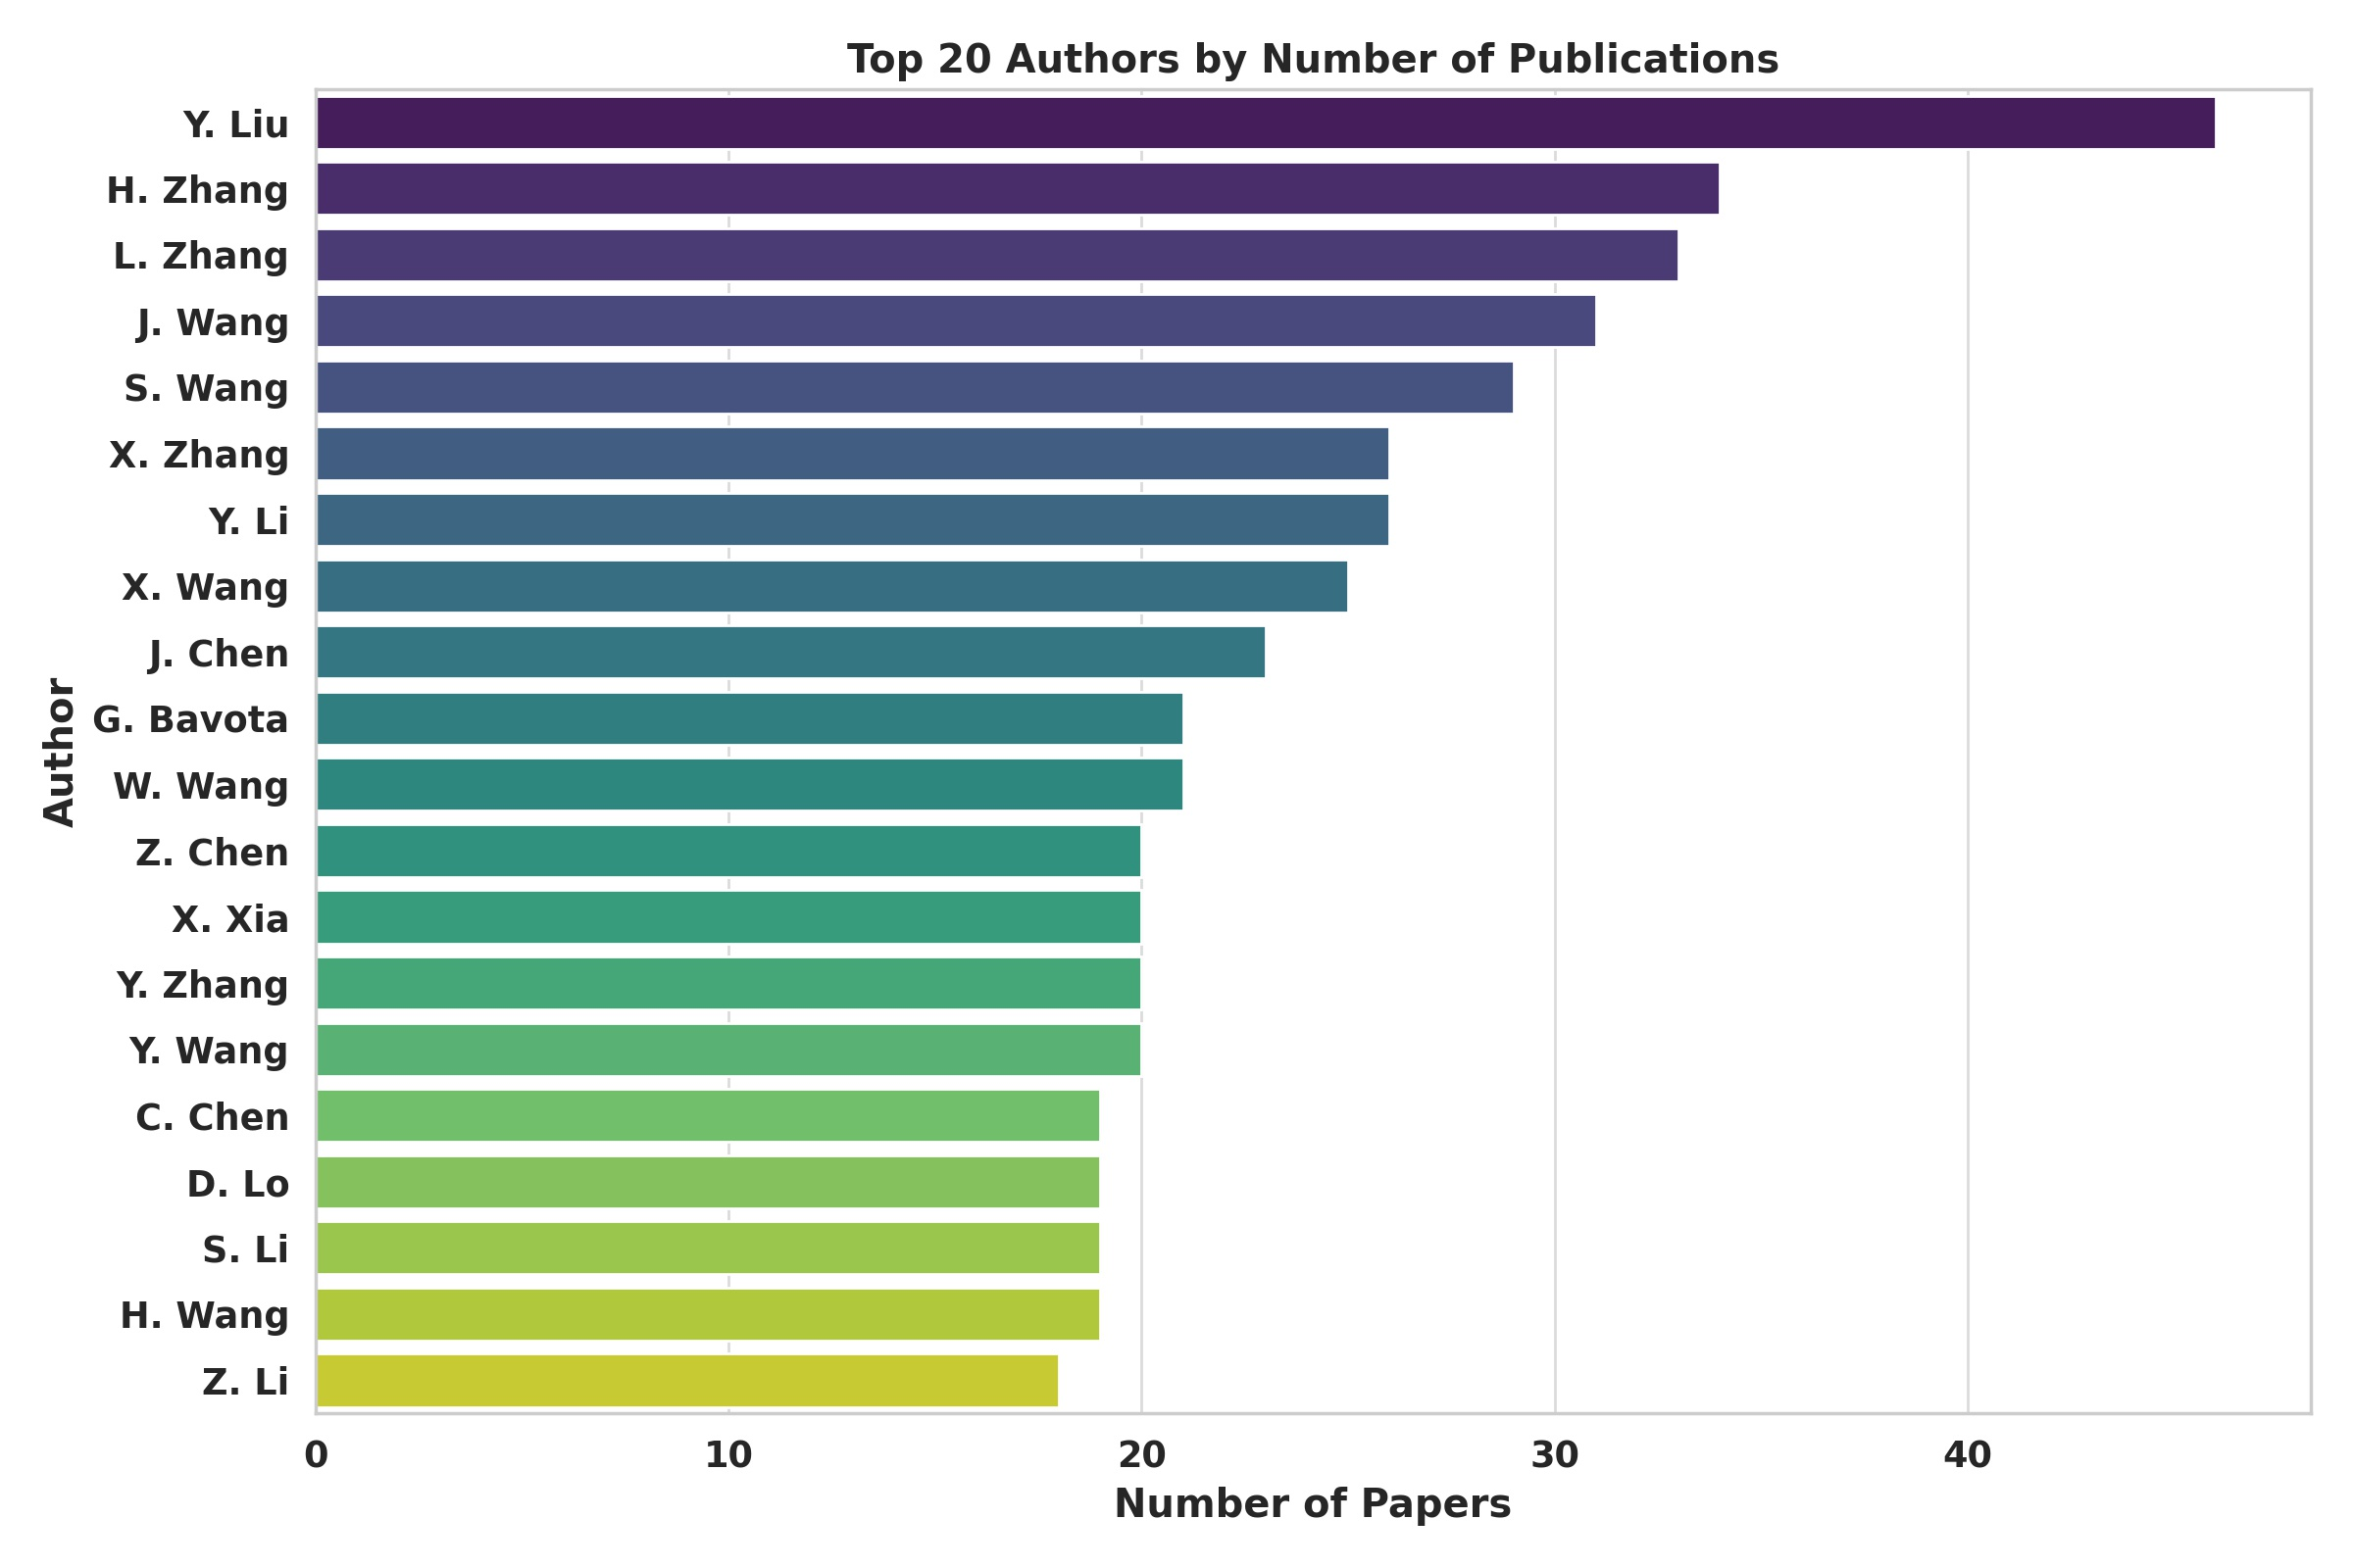
Exploratory Data Analysis
Author Analysis to understand the distribution of papers per author and identify authors with the most publications
Notes:
The visualized bar chart represents the top 20 authors in terms of the number of publications they've contributed to the ICSE conference.
Description:
The chart offers a hierarchical view of the authors based on their publication counts in the dataset.
The author at the top of the chart has the highest number of papers, indicating their prolific contributions to the ICSE community.
The gradient color scheme, facilitated by the 'viridis' palette, stresses the ranking order, with the most prominent authors in deeper shades.
The bolder font enhances clarity and ensures easy comprehension of the chart's contents.
Such an author analysis is instrumental in pinpointing key contributors, thought leaders, and influential researchers within the ICSE community. It can also shed light on potential collaborators, mentors, or experts in specific research areas.

Slide 14
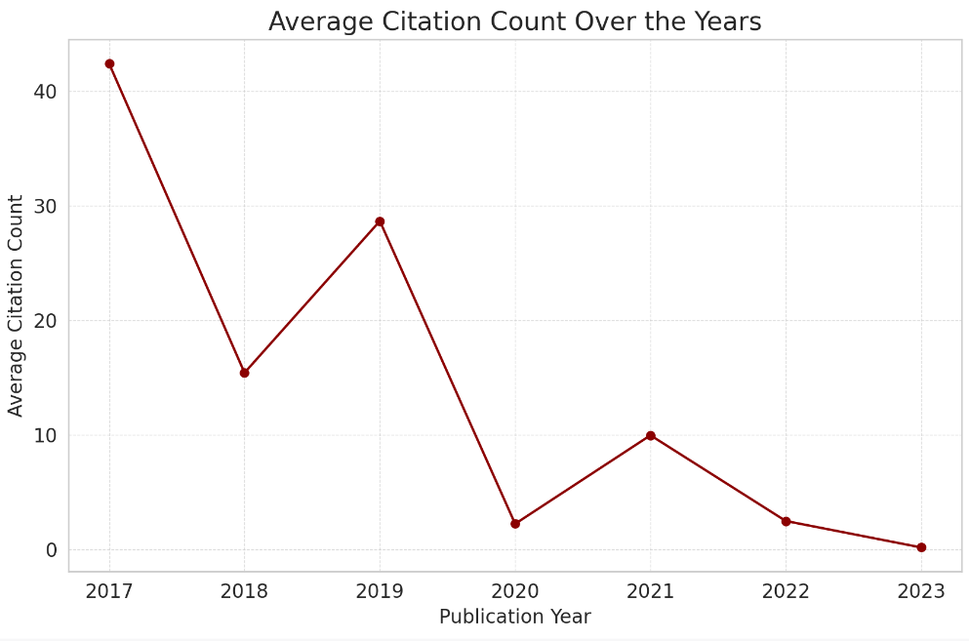
Exploratory Data Analysis
Time-Based Citation Analysis
Notes:
The average citation count is understandably lower for the most recent years (2022 and 2023), as these papers have had less time to accumulate citations.
There's a noticeable peak in 2018, indicating that papers published in this year, on average, received a higher number of citations compared to neighboring years.

Slide 15
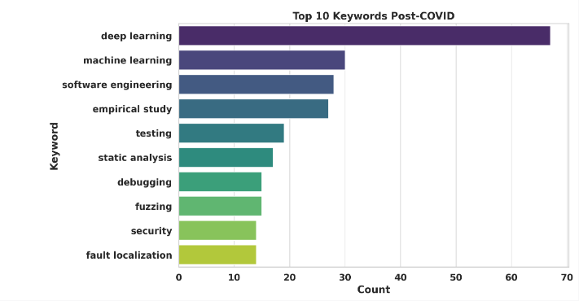
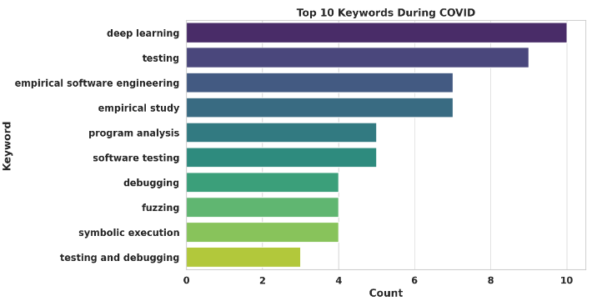
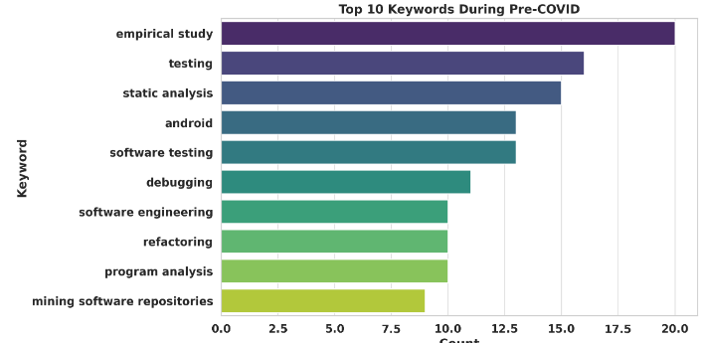
Exploratory Data Analysis
Temporal Keyword Trends to identify the most popular keywords for each time period
Notes:
1. Top 10 Keywords During Pre-COVID:
This chart displays the most frequent keywords from papers published before the onset of the COVID-19 pandemic. By examining these keywords, we can discern the primary research themes and topics that dominated the ICSE community before the pandemic.
2. Top 10 Keywords During COVID:
This chart reveals the predominant keywords from papers published during the COVID-19 pandemic. This provides insights into the research areas that gained prominence or relevance during the pandemic, potentially reflecting the community's response to the global crisis.
3. Top 10 Keywords Post-COVID:
This chart presents the leading keywords from papers published after the pandemic. It offers a glimpse into the evolving research directions and priorities as the academic community adapted to the post-pandemic landscape.
Description:
Each bar within the charts corresponds to a keyword, with its length signifying the frequency of its occurrence.
The gradient coloration, facilitated by the 'viridis' palette, emphasizes the ranking of keywords.
The bolder font style ensures easy readability and clarity of the charts' contents.

Slide 16
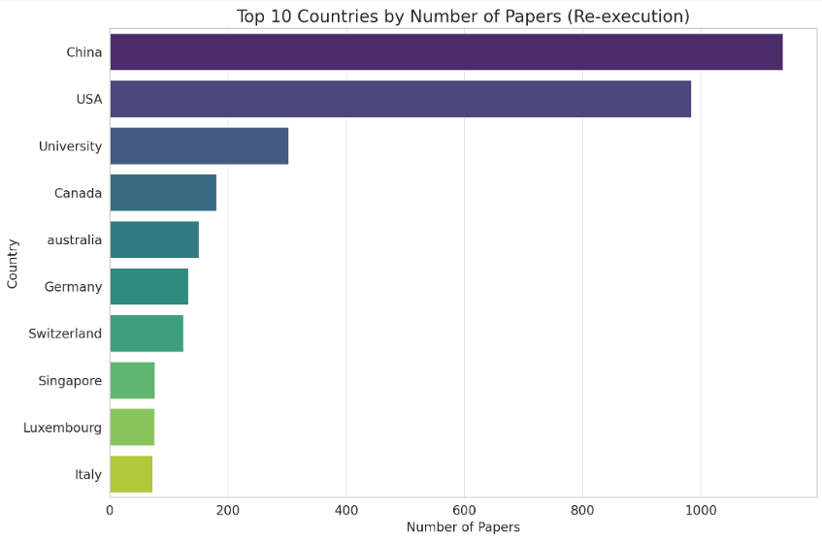
Exploratory Data Analysis
Top 10 Countries by Number of Papers
Notes:
1. Top 10 Keywords During Pre-COVID:
This chart displays the most frequent keywords from papers published before the onset of the COVID-19 pandemic. By examining these keywords, we can discern the primary research themes and topics that dominated the ICSE community before the pandemic.
2. Top 10 Keywords During COVID:
This chart reveals the predominant keywords from papers published during the COVID-19 pandemic. This provides insights into the research areas that gained prominence or relevance during the pandemic, potentially reflecting the community's response to the global crisis.
3. Top 10 Keywords Post-COVID:
This chart presents the leading keywords from papers published after the pandemic. It offers a glimpse into the evolving research directions and priorities as the academic community adapted to the post-pandemic landscape.
Description:
Each bar within the charts corresponds to a keyword, with its length signifying the frequency of its occurrence.
The gradient coloration, facilitated by the 'viridis' palette, emphasizes the ranking of keywords.
The bolder font style ensures easy readability and clarity of the charts' contents.

Slide 17
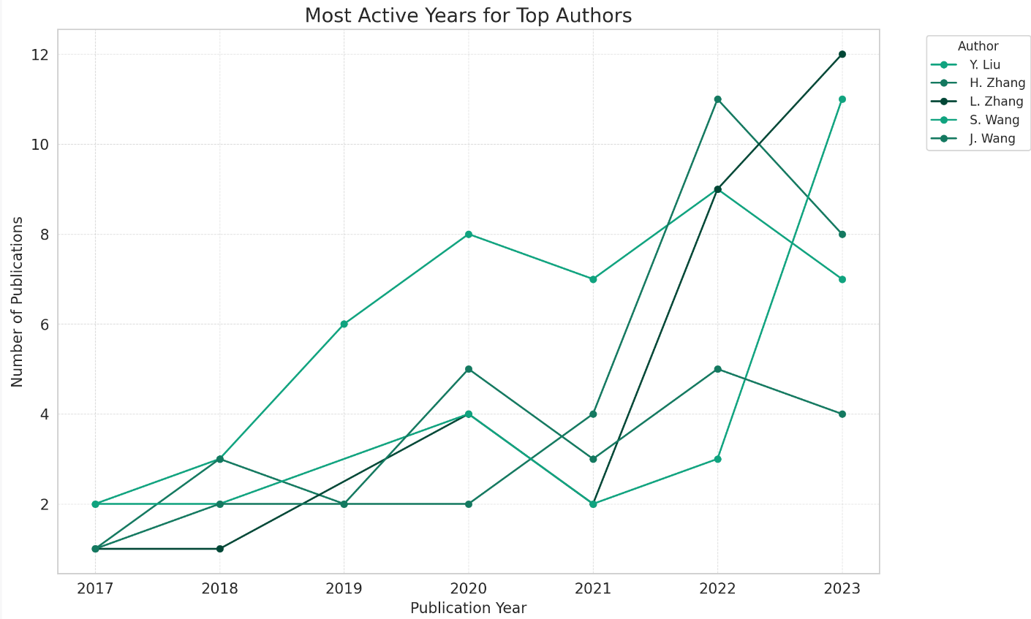

Exploratory Data Analysis
Most active authors
Notes:
The bar chart showcases the distribution of unique keywords used in papers for each year:
There's a general upward trend in the diversity of research topics, as indicated by the increasing number of unique keywords over the years.
2023 has the highest diversity of research topics, with the maximum number of unique keywords.

Slide 18
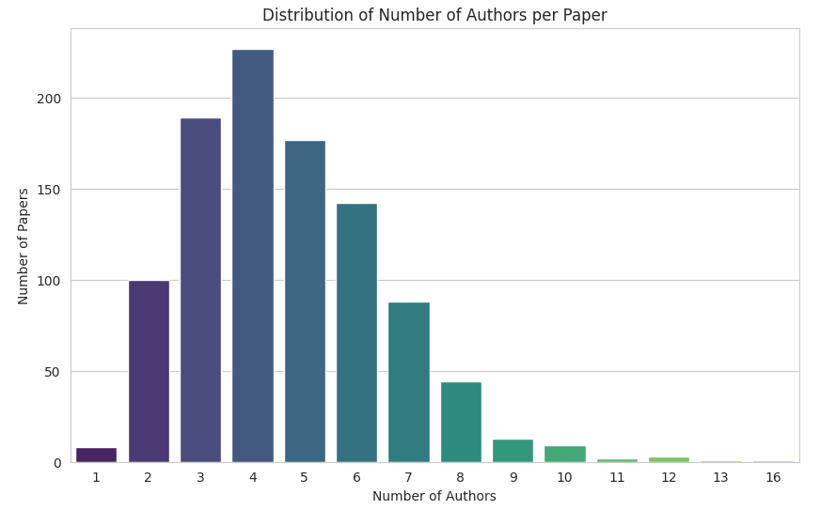
Exploratory Data Analysis
Distribution of Single vs. Multi-Author Papers
Notes:
The visualization depicts the distribution of the number of authors per paper:
Most papers have between 2 and 5 authors.
Fewer papers have collaborations with more than 5 authors.
It's relatively rare for papers to have collaborations with 8 or more authors.

Slide 19
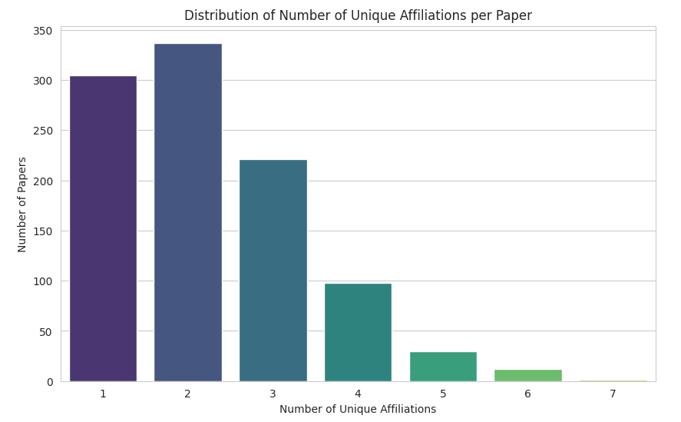
Exploratory Data Analysis
Affiliation Diversity per Paper
Notes:
Affiliation diversity per paper refers to the variety of institutions, organizations, or universities associated with the authors of a given paper. A high affiliation diversity indicates that the authors of the paper come from different affiliations, suggesting a broad collaboration scope.

Slide 20
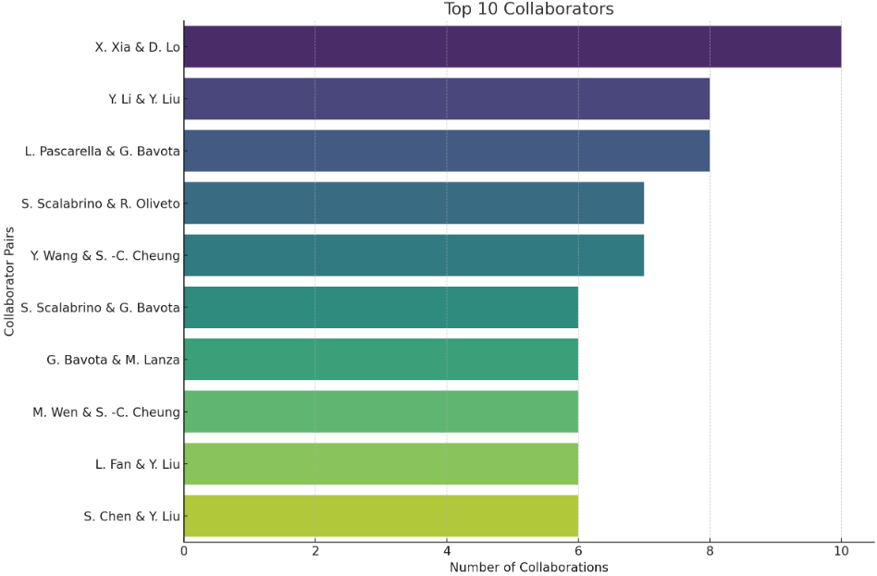
Exploratory Data Analysis
Top 10 collaborators

Slide 21
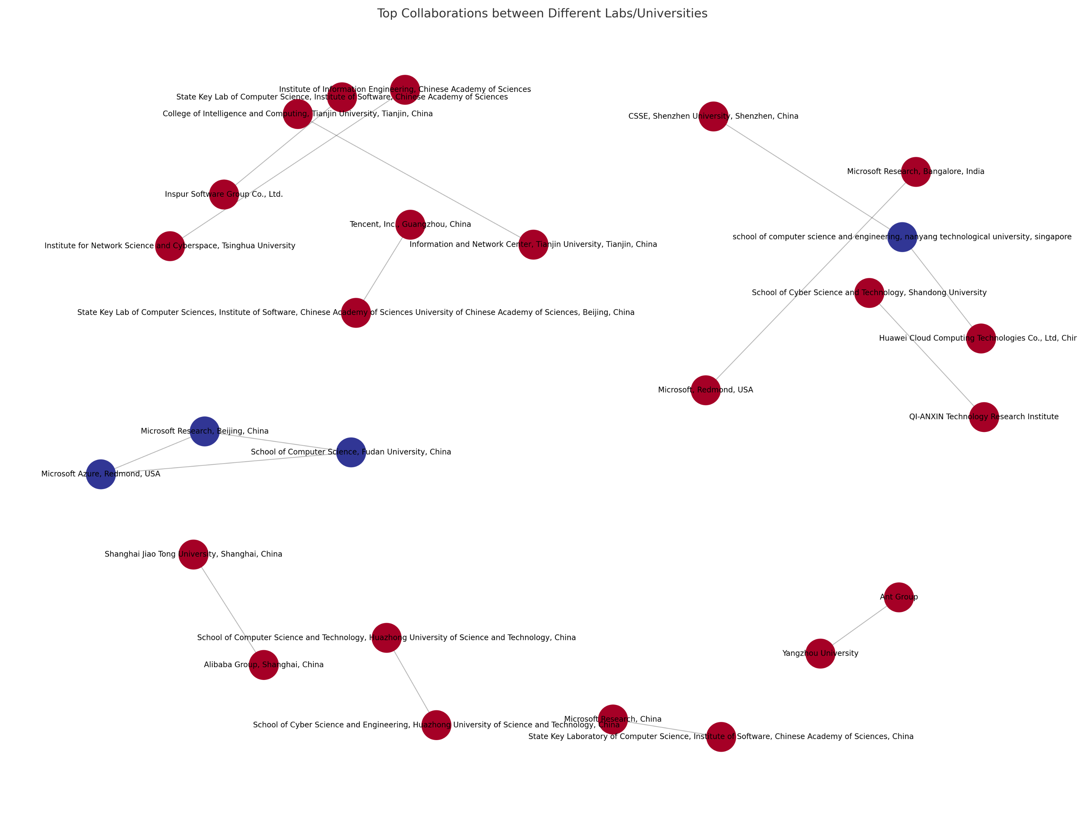
Exploratory Data Analysis
Top 10 collaborator lab/universities

Slide 22
Topic modelling
Latent Dirichlet Allocation (LDA)
Text Preprocessing:
Tokenize the titles.
Remove stop words.
Lemmatize or stem the words.
LDA Model Training:
Use the processed titles to train an LDA model.
Extract Topics:
Display the top words for each topic identified by the LDA model.

Slide 23
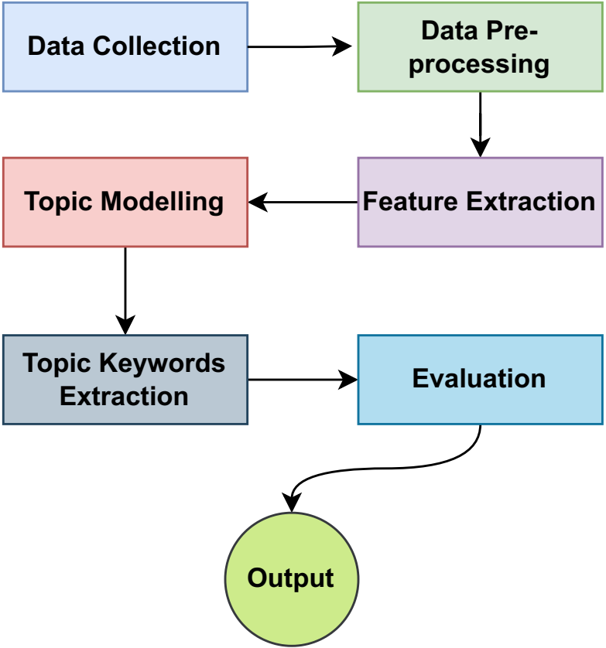
Topic modelling
Latent Dirichlet Allocation (LDA)

Slide 24
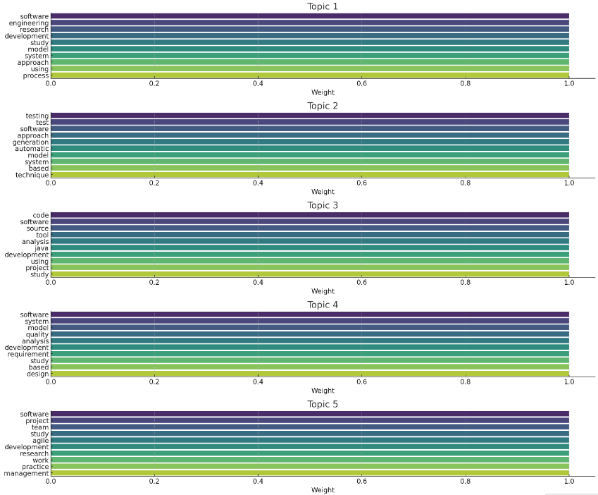
LDA Topic modelling

Slide 25
Evaluation
Latent Dirichlet Allocation (LDA)
Metric | Value
Perplexity | 308.943270
Coherence | 0.342343

